Slide 1
AIML Capstone Project - CV - Car detection
Jun20A Group 6B
- Antara
- Deepiga
Gowthaman
Manoj
- Shashank

Slide 2
Project Details
Project Objective: Design a DL based car identification model
Domain: Automotive. Surveillance
Context: Computer vision can be used to automate supervision and generate action appropriate action trigger if the event is predicted from the image of interest. For example a car moving on the road can be easily identified by a camera as make of the car, type, colour, number plates etc .
Data Description: The Cars dataset contains 16,185 images of 196 classes of cars. The data is split into 8,144 training images and 8,041 testing images, where each class has been split roughly in a 50-50 split. Classes are typically at the level of Make, Model, Year, e.g. 2012 Tesla Model S or 2012 BMW M3 coupe.
Data description:
‣ Train Images: Consists of real images of cars as per the make and year of the car.
‣ Test Images: Consists of real images of cars as per the make and year of the car.
‣ Train Annotation: Consists of bounding box region for training images.
‣ Test Annotation: Consists of bounding box region for testing images

Slide 3
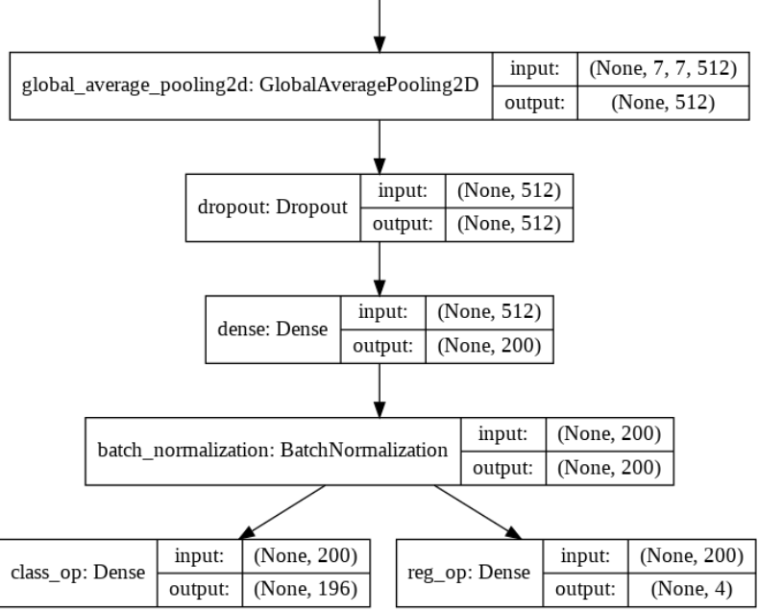
VGG16
Model - Key Details:
Used Transfer Learning Approach
VGG16 is the Back bone architecture
Input Image size is 224*224*3
Used ‘Imagenet’ weights
Image Augmentation not done
Optimizer = Adam
Loss for box co-oridinates =‘mse’
Loss for Classification = ‘categorical_crossentropy’
Metric for box co-oridinates =‘IoU’
Metric for box Classification =‘Accuracy’
Trainable params: 143,200
Non-trainable params: 14,715,088
Training & Validation Accuracy for Classification = 0.11 & 0.001
Training & Validation IoU for Bounding Boxes = 0.004 & 0.004
Model Architecture:
Pretrained VGG16 Model Excluding Top Layer
Additional References:
Data Preparation steps for Modeling
Defining Batch Generator function
Defining IoU calculation function

Slide 4
Consolidated Model Results

Slide 5
Future Steps
Training without ‘imagenet’ weight
Image classification using Image Augmentation tool
Separate model building for Classification & Detection
Week 4
Week 5
Week 6

Slide 6
Annexure
Create single doc/text file attach it to the annexure.

Slide 7
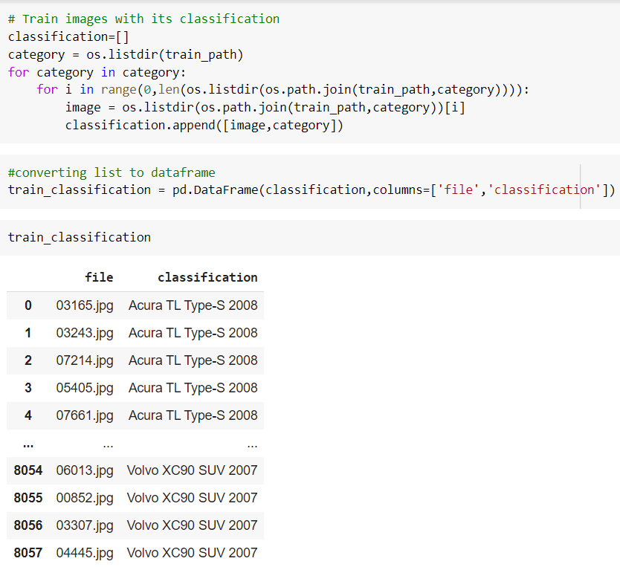
Data Preparation for Modelling
Mapping of Images in train folder with it class and storing in a dataframe

Slide 8
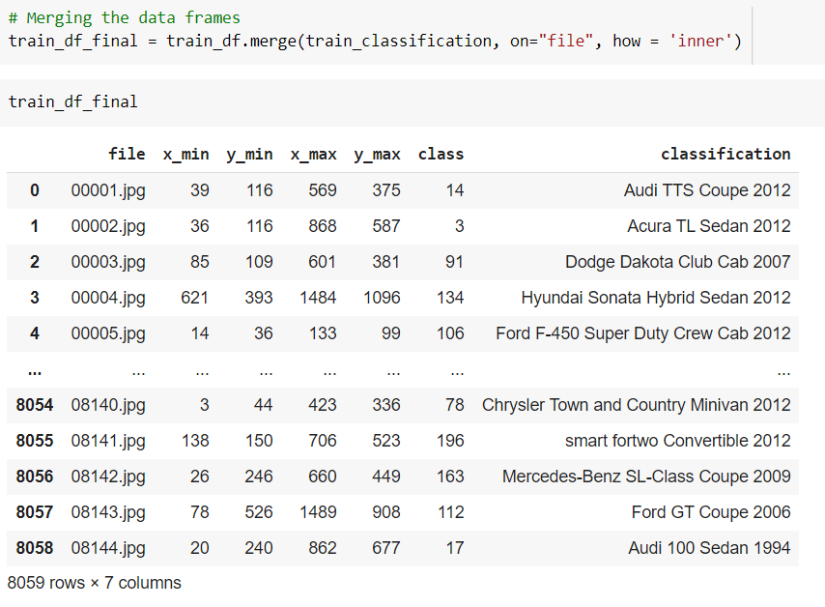
Data Preparation for Modelling
Train Images with the classification are merged with respective the bounding box Co-ordinates

Slide 9
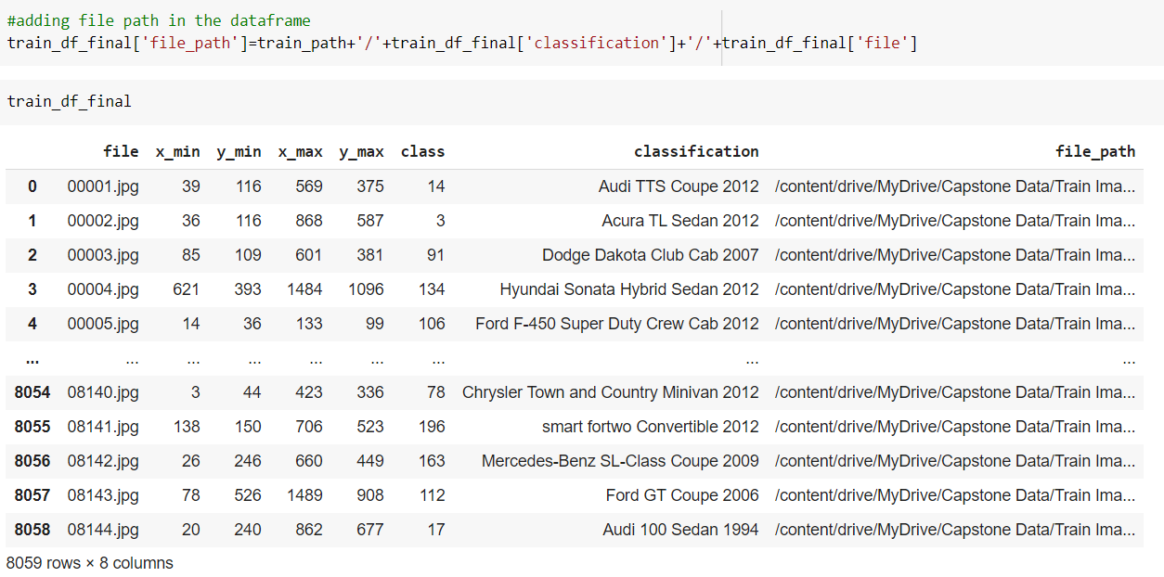
Data Preparation for Modelling
File path has been added against each training images , so that we can create the pipeline to access the images at ease

Slide 10
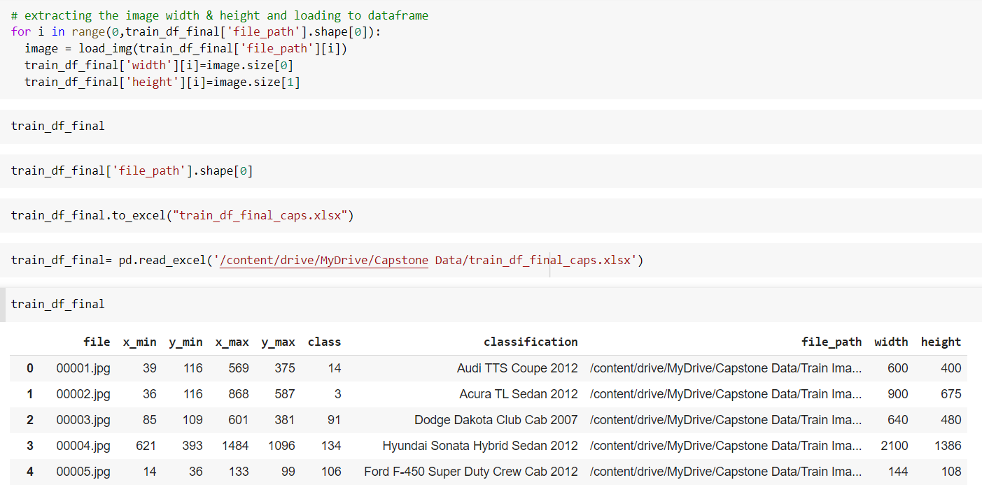
Data Preparation for Modelling
Image width and height is mapped against the following function , it will be required when we have to modify the bounding box coordinates based on the resized images

Slide 11
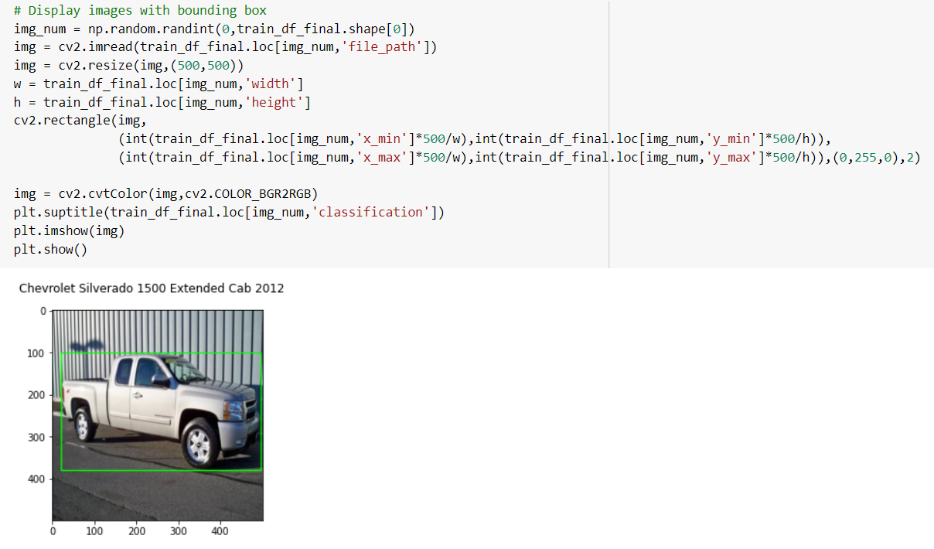
Data Preparation for Modelling
Cv2 library is used to display the random images with it bounding boxes
Back to Summary Page :

Slide 12
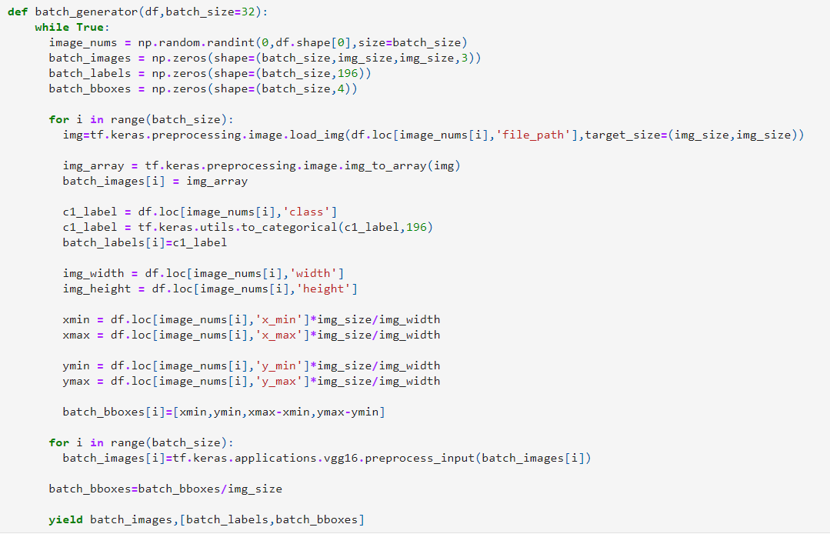
Defining Batch Generator function
Back to Summary Page :

Slide 13
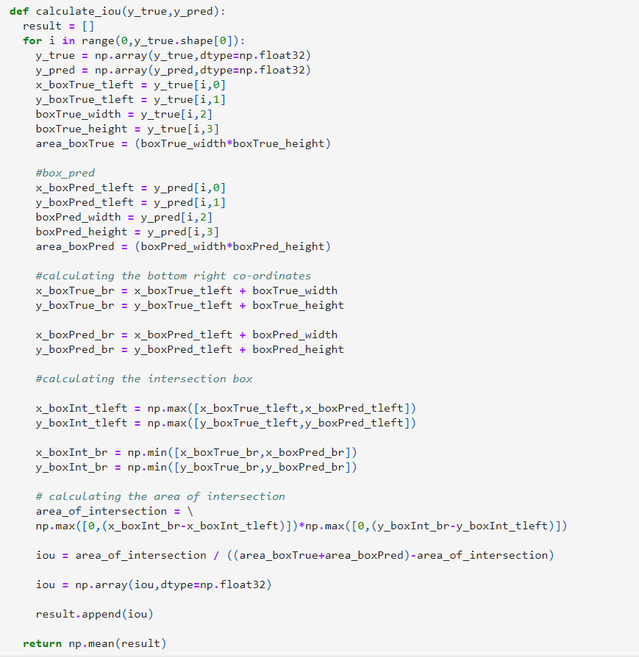
Defining IoU calculation function
Back to Summary Page :

